Slide 1

A Project Review Meeting on Shopping Cart & Checkout Flow
By
Name: Dhanush roll: 2520030014
Name: Pranav roll:2520030555
Team Number: 26
Under the guidance of
Dr. Pavitra
Associate Professor
Department of Computer Science and Engineering
Koneru Lakshmaiah Education Foundation (Deemed to be University estd. u/s. 3 of the UGC Act, 1956) Off-Campus: Bachupally-Gandimaisamma Road, Bowrampet, Hyderabad, Telangana - 500 043. Phone No: 7815926816, www.klh.edu.in

Slide 2
Outline of the Presentation
Abstract
Introduction
Problem Statement
Project Flow Diagram
Objectives with Justification
Modules[Frontend web pages]
Expected Outcomes of the Proposed Work
Conclusion
References

Slide 3
Abstract
This project is a solid implementation of a multi-step Shopping Cart and Checkout Flow in the React and Node.js ecosystem. The system uses Context API to hold the global state and allows data persistence across a 10-module journey involving dynamic cart updates, validated address forms, and a back end driven coupon engine. The architecture is built to deliver a smooth user experience, with tight data synchronization from product selection to the final order confirmation.
The back end is built using Express.js, which enables the centralization of important logic, such as price calculations and discount validation, to prevent client-side manipulation and to maintain financial integrity. The system uses Axios for API calls and LocalStorage for session persistence, and provides an overview of the order lifecycle. This project is a scalable template for modern high-stakes transactional workflows.

Slide 4
Introduction
This project is a robust, scalable e-commerce solution featuring a comprehensive multi-step checkout flow built with React and Node.js. Powered by the Context API and LocalStorage, it ensures seamless data persistence and dynamic cart updates across a 10-module user journey.
The Express.js backend centralizes critical price calculations and coupon validation, preventing client-side manipulation to maintain financial integrity. Driven by Axios for secure API communication, this architecture delivers a synchronized order lifecycle, serving as a production-ready template for modern, high-stakes transactional workflows.

Slide 5
Problem Statement
Modern e-commerce platforms often struggle with fragmented user experiences and security vulnerabilities during the checkout process. Client-side state management frequently leads to data loss during multi-step journeys, resulting in high cart abandonment rates. Furthermore, relying on the frontend for price calculations and discount validation exposes applications to malicious manipulation, compromising financial integrity.
There is a critical need for a scalable, highly synchronized checkout architecture that ensures seamless data persistence across complex user flows while centralizing sensitive business logic on the backend to guarantee secure, tamper-proof transactions.

Slide 6
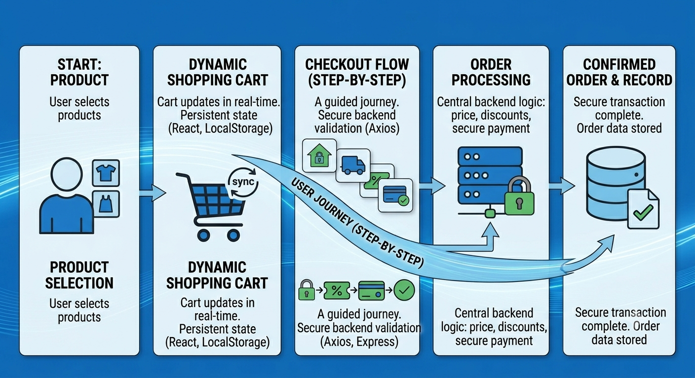
Project Flow Diagram

Slide 7
Objectives with Justification
Secure Pricing & Revenue Protection:
All price calculations and coupon validations are handled on the Express.js backend to prevent client-side tampering and guarantee financial integrity.
Persistent User Data:
React Context API and LocalStorage save user progress across the 10-module journey, ensuring cart and address details aren't lost during page refreshes, reducing checkout abandonment.
Instant Data Synchronization:
Axios manages real-time, asynchronous updates between the frontend and backend, providing users with immediate feedback on dynamic totals without disrupting the flow with full page reloads.
Modular & Scalable Design:
The entire checkout system is broken down into independent, reusable React components, simplifying debugging and allowing future features or payment methods to be added effortlessly.
End-to-End Lifecycle Tracking:
The application monitors the entire order journey from product selection to final confirmation, making it easy to log system errors and pinpoint exactly where users drop off.

Slide 8
Modules [Frontend web pages]
1. Product Selection & Dynamic Cart:
The entry point where users browse products and add items to a dynamic cart page that instantly updates totals and persists data across refreshes using Context API.
2. User Gateway & Shipping Details:
A seamless transition page handling User Sign-In or Guest Checkout, immediately followed by a fully validated Shipping Address form to capture delivery details.
3. Shipping & Coupon Validation:
A dynamic interface where users select shipping speeds and input promo codes, sending real-time requests via Axios to the backend for secure cost and discount calculations.
4. Order Review & Secure Payment:
A final itemized summary page for users to verify their complete breakdown (taxes, shipping, discounts) before entering details into a secure, tokenized payment interface.
5. Processing & Order Confirmation:
A state-driven loading screen that prevents double-submitting while the backend finalizes the transaction, leading to a final receipt page with a unique order ID and tracking details.

Slide 9
Expected Outcomes of the Proposed Work
1. Flawless Financial Integrity:
Moving all logic to the Express.js backend eliminates frontend vulnerabilities, ensuring 100% accurate, tamper-proof price calculations and coupon validations.
2. Zero Checkout Data Loss:
Combining Context API and LocalStorage preserves user progress and cart items across all steps, eliminating frustration from accidental page refreshes and lowering abandonment rates.
3. Instant, Lag-Free Responsiveness:
Axios-driven communication ensures real-time updates for totals, shipping costs, and discounts, delivering a highly responsive, app-like shopping experience without full-page reloads.
4. Production-Ready, Scalable Code:
A modular, componentized architecture provides a clean, maintainable template that allows developers to debug easily and plug in future features like new payment gateways effortlessly.
5. Clear User Journey Visibility:
End-to-end tracking delivers a reliable audit trail for every transaction, making it easy to monitor system performance and pinpoint exactly where users drop off.

Slide 10
Conclusion and Future Scope
Conclusion:
This project delivers a secure, high-performance checkout system by separating frontend user experience from backend business logic. Utilizing React and Express.js, the architecture guarantees a seamless, data-persistent user journey while maintaining total financial integrity. It stands as a robust, scalable template ready for modern, high-stakes e-commerce applications.
Future Scope:
Full Payment Integration: Connect actual payment gateways like Stripe or PayPal to handle real money securely.
Smart AI Discounts: Use basic AI to suggest personalized coupon codes and extra product add-ons at checkout.
Automated Address Checking: Add tools like Google Maps to auto-fill and verify shipping addresses instantly.
Admin Analytics Dashboard: Create a simple tracking dashboard so store owners can see exactly where users drop off and quit the checkout.

Slide 11
References
Some References:
Flanagan, D. (2020). JavaScript: The Definitive Guide. O'Reilly Media.
Relevance: Explains client-side data persistence storage patterns (LocalStorage) and asynchronous data fetching architecture via APIs.
Banks, A., & Porcello, E. (2020). Learning React: Modern Patterns for Developing React Apps. O'Reilly Media.
Relevance: Covers global state management using the React Context API, modular component design, and handling complex multi-step user interfaces.
*Node.js & Express.js Documentation (Official).
Relevance: Serves as the primary reference for building secure, server-side validation layers, managing route structures, and preventing client-side data manipulation in transactional workflows.

Slide 12
Thank you

